Slide 1
“Let’s Build Cool Websites with ReactJS!”
Priyanka MAThur Soni, Nivedha

Slide 2
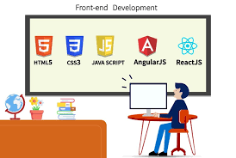
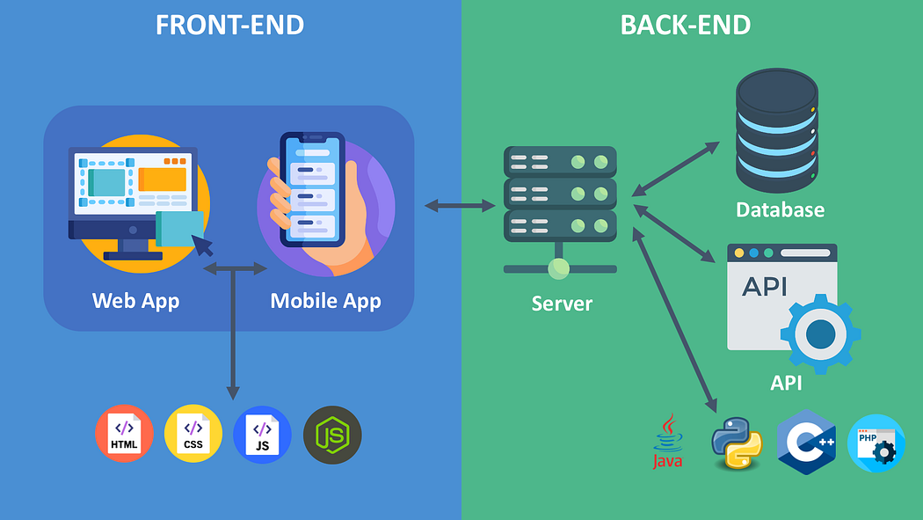
What is frontend development
Frontend development is the visible part of a website that users see and interact with.
It includes buttons, text, images, colors, and layout.
Example: When you open YouTube, the videos, buttons, search bar → all are frontend.

Slide 3
Introduction to HTML, CSS, and JavaScript
HTML (HyperText Markup Language) – Structure
HTML is the skeleton of a web page.
It defines headings, paragraphs, images, links, tables, forms, etc.
HTML = What you see (content).

Slide 4
HTML Concepts
Forms
Block & Inline
Tables
Semantic elements
Attributes

Slide 5
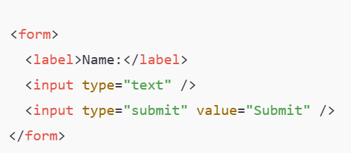
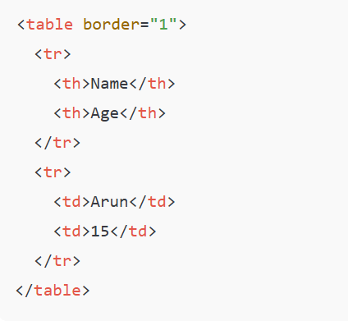
Tables
Forms
Collects user input.
A table in HTML consists of table cells inside rows and columns.

Slide 6
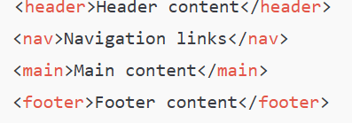
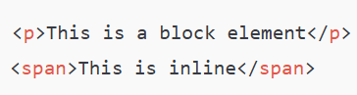
Semantic Elements
Block and Inline Elements
Block → starts on a new line (<div>, <p>, <h1>)
Inline → does not start on a new line (<span>, <a>, <strong>)
Gives meaning to the structure of a page.
Attributes
Provide extra information about elements.

Slide 7
For more, please refer: HTML Tutorial

Slide 8
Introduction to CSS
CSS (Cascading Style Sheets) – Design
CSS is the clothing/decoration of a web page.
It controls colors, fonts, layouts, backgrounds, spacing.
CSS = How it looks (style)

Slide 9
CSS Concepts
Three ways of using style sheet
Box Model
Media Queries
Flex box
Grid

Slide 10
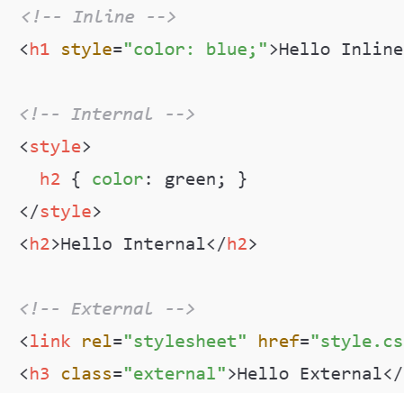
Three ways of using CSS
Three ways of using CSS
✅ Inline CSS → Styling directly inside the element
✅ Internal CSS → Inside <style> tag in HTML
✅ External CSS → Separate .css file

Slide 11
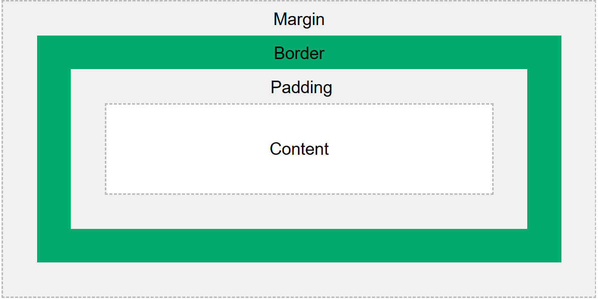
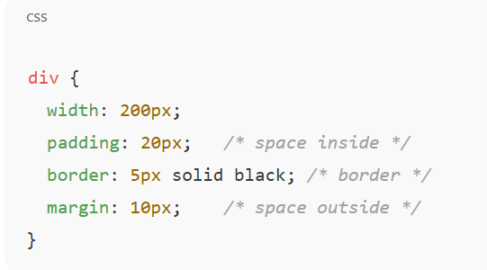
Box Model (content, padding, border, margin)
Every element in HTML is a box.

Slide 12
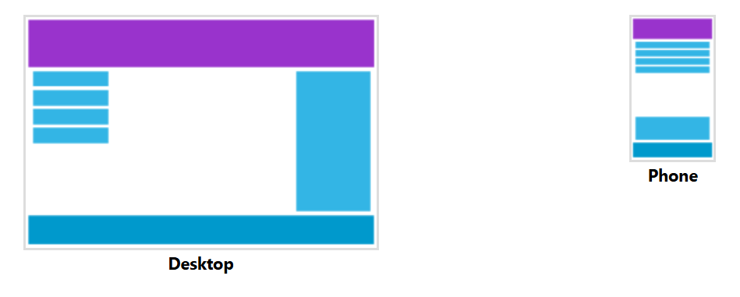
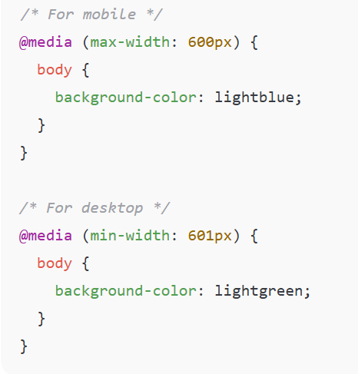
Media Queries (Responsive Design)
📱 Change style based on device width.

Slide 13
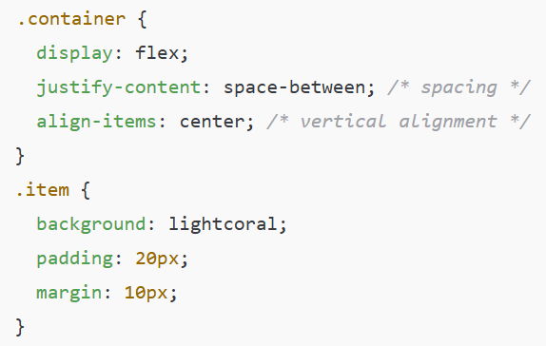
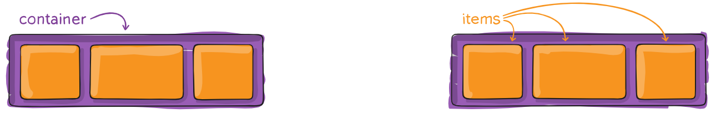
Flexbox (Flexible Box Layout)
🔄 Arrange items easily in row/column.

Slide 14
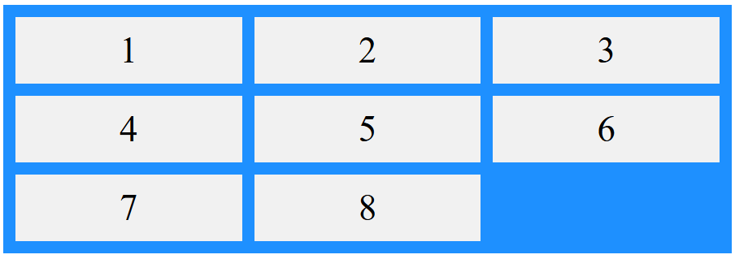
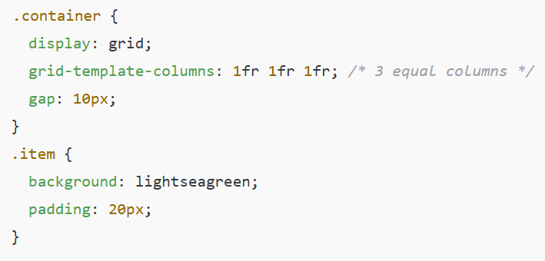
Grid Layout
🟦 Divide page into rows & columns.

Slide 15
For more, please refer: CSS Tutorial

Slide 16
Introduction to JavaScript
JavaScript – Interactivity
JavaScript makes web pages dynamic and interactive.
It can respond to clicks, inputs, animations, validations.
JavaScript = How it behaves (interactivity)
Example: Playground | MDN

Slide 17
Javacript Concepts
Variables : Variables
Date Types: Data types
Loops: Loops: while and for
Switch statement: The "switch" statement
Logical Operators: Logical operators
Functions: Functions
Arrow functions: Arrow functions, the basics
Objects: Objects
Arrays: Arrays
Destructuring : Destructuring assignment
Mouse events: Mouse events
Fetch: Fetch
Localstorage & Sessionstorage :
LocalStorage, sessionStorage
Async/await

Slide 18
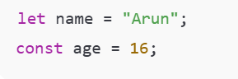
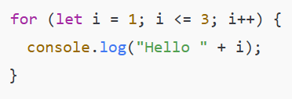
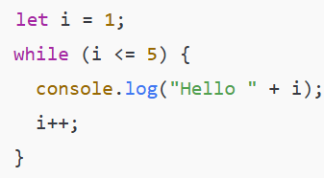
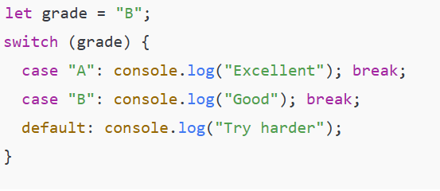
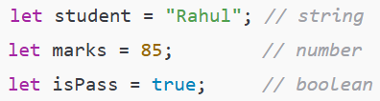
Javacript Concepts
Variables: Used to store data.
Data Types: string, number, boolean, object, array, null, undefined.
Loops: Run code repeatedly.
Switch Statement: Choose one case out of many.

Slide 19
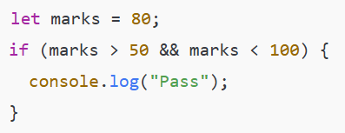
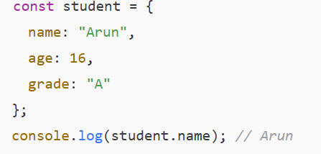
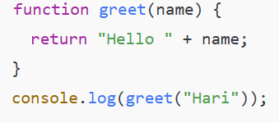
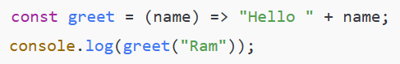
Javacript Concepts
Logical Operators: && (AND), || (OR), ! (NOT).
Functions: Block of code that performs a task.
Objects : Store data in key-value pairs.
Arrow functions: Shorter way to write functions.

Slide 20
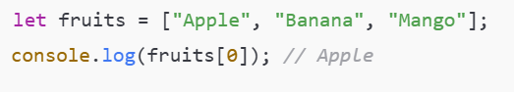
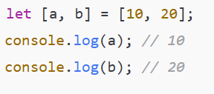
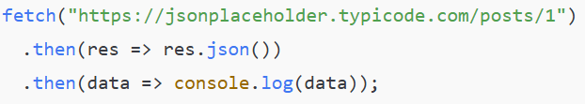
Javacript Concepts
Arrays : A collection of values stored in a single variable.
Destructuring : Extract values from arrays or objects easily.
Mouse Events : Events that happen when the user interacts with the mouse
Fetch (API calls) : Used to get data from a server.

Slide 21
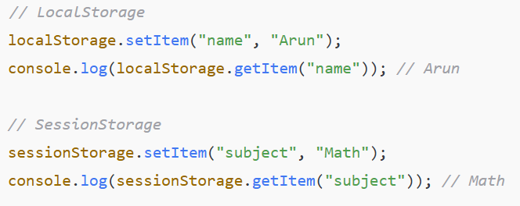
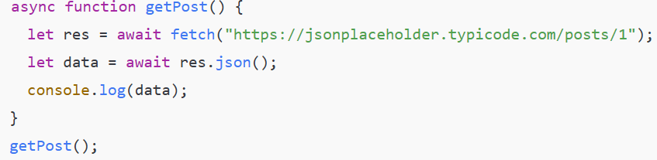
Javacript Concepts
LocalStorage & SessionStorage : Store data in the browser.
Async/Await : A cleaner way to write asynchronous code.

Slide 22
For more, please refer: The Modern JavaScript Tutorial

Slide 23
Developer Tools
Built inside Chrome (Right click → Inspect).
Used by developers to:
- Inspect elements (see the HTML & CSS behind a page).
- Debug JavaScript (find and fix errors).
- Check responsiveness (how a website looks on mobile/desktop).

Slide 24
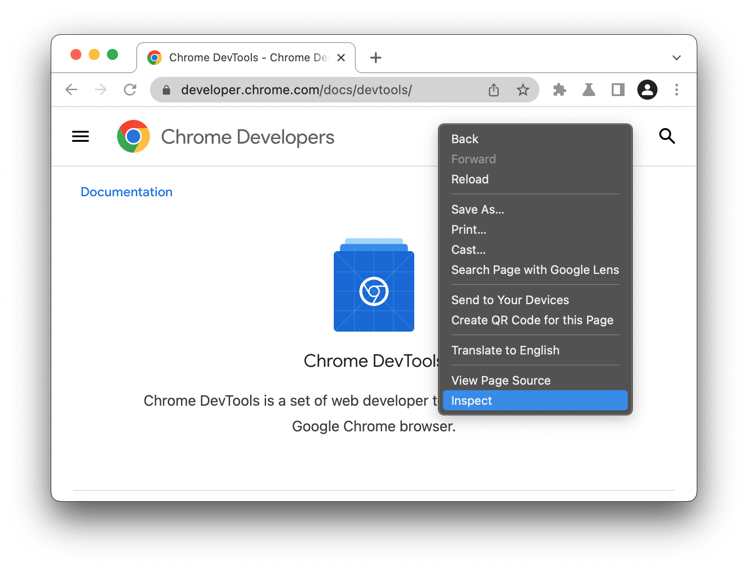
Developer Tools

Slide 25
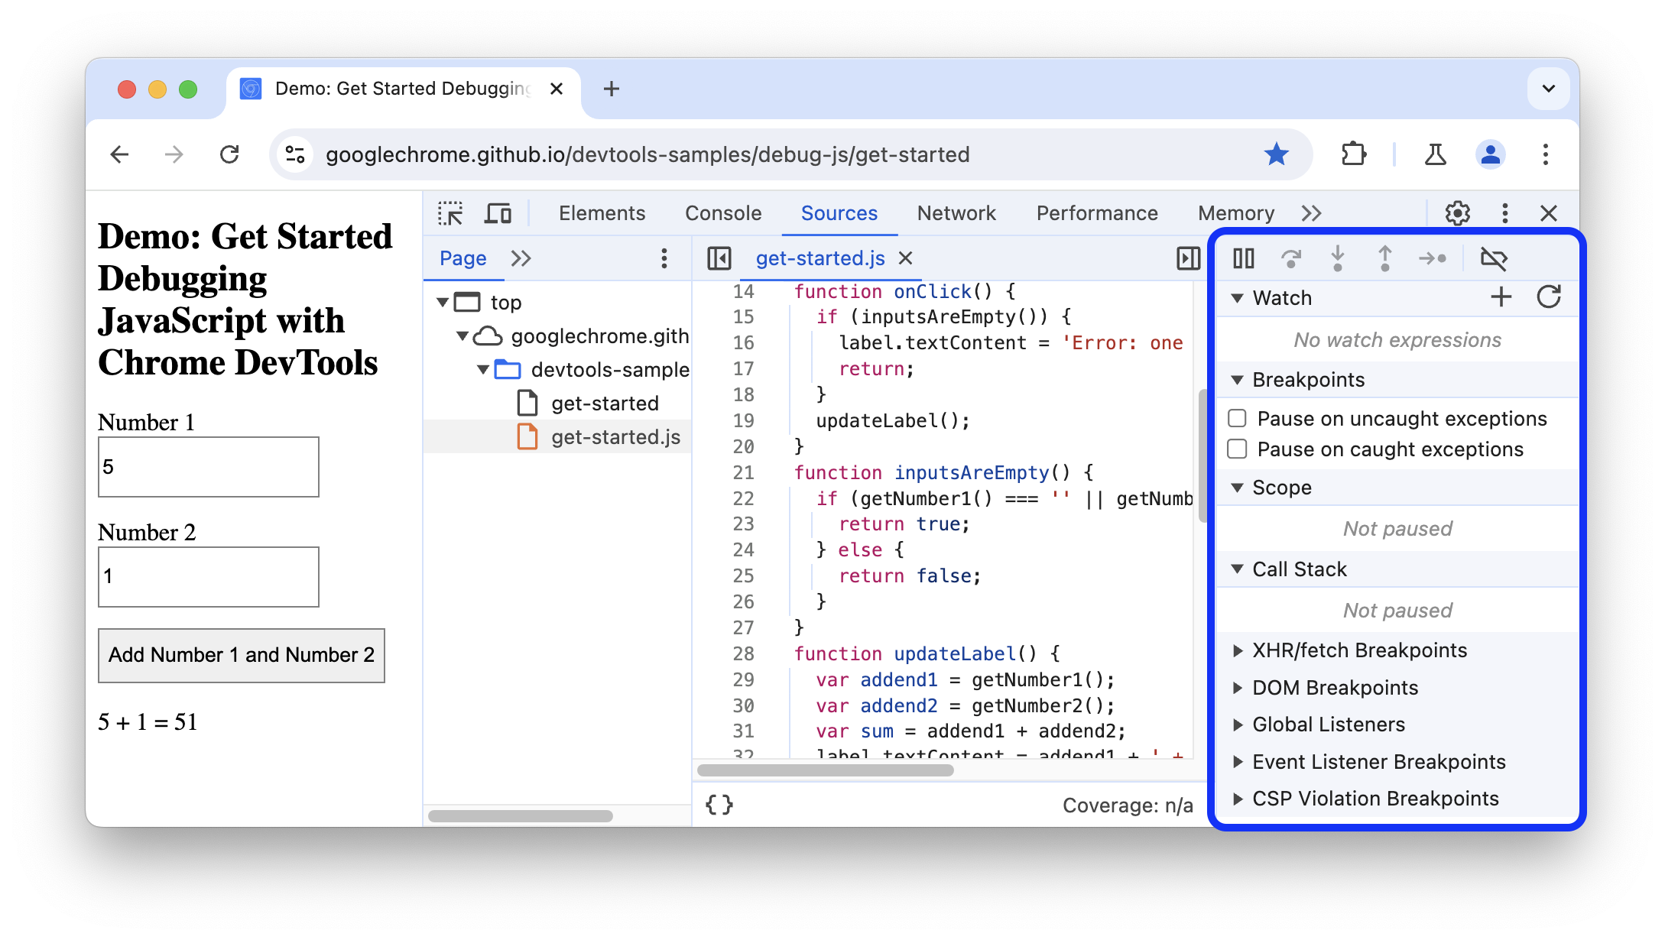
Developer Tools

Slide 26
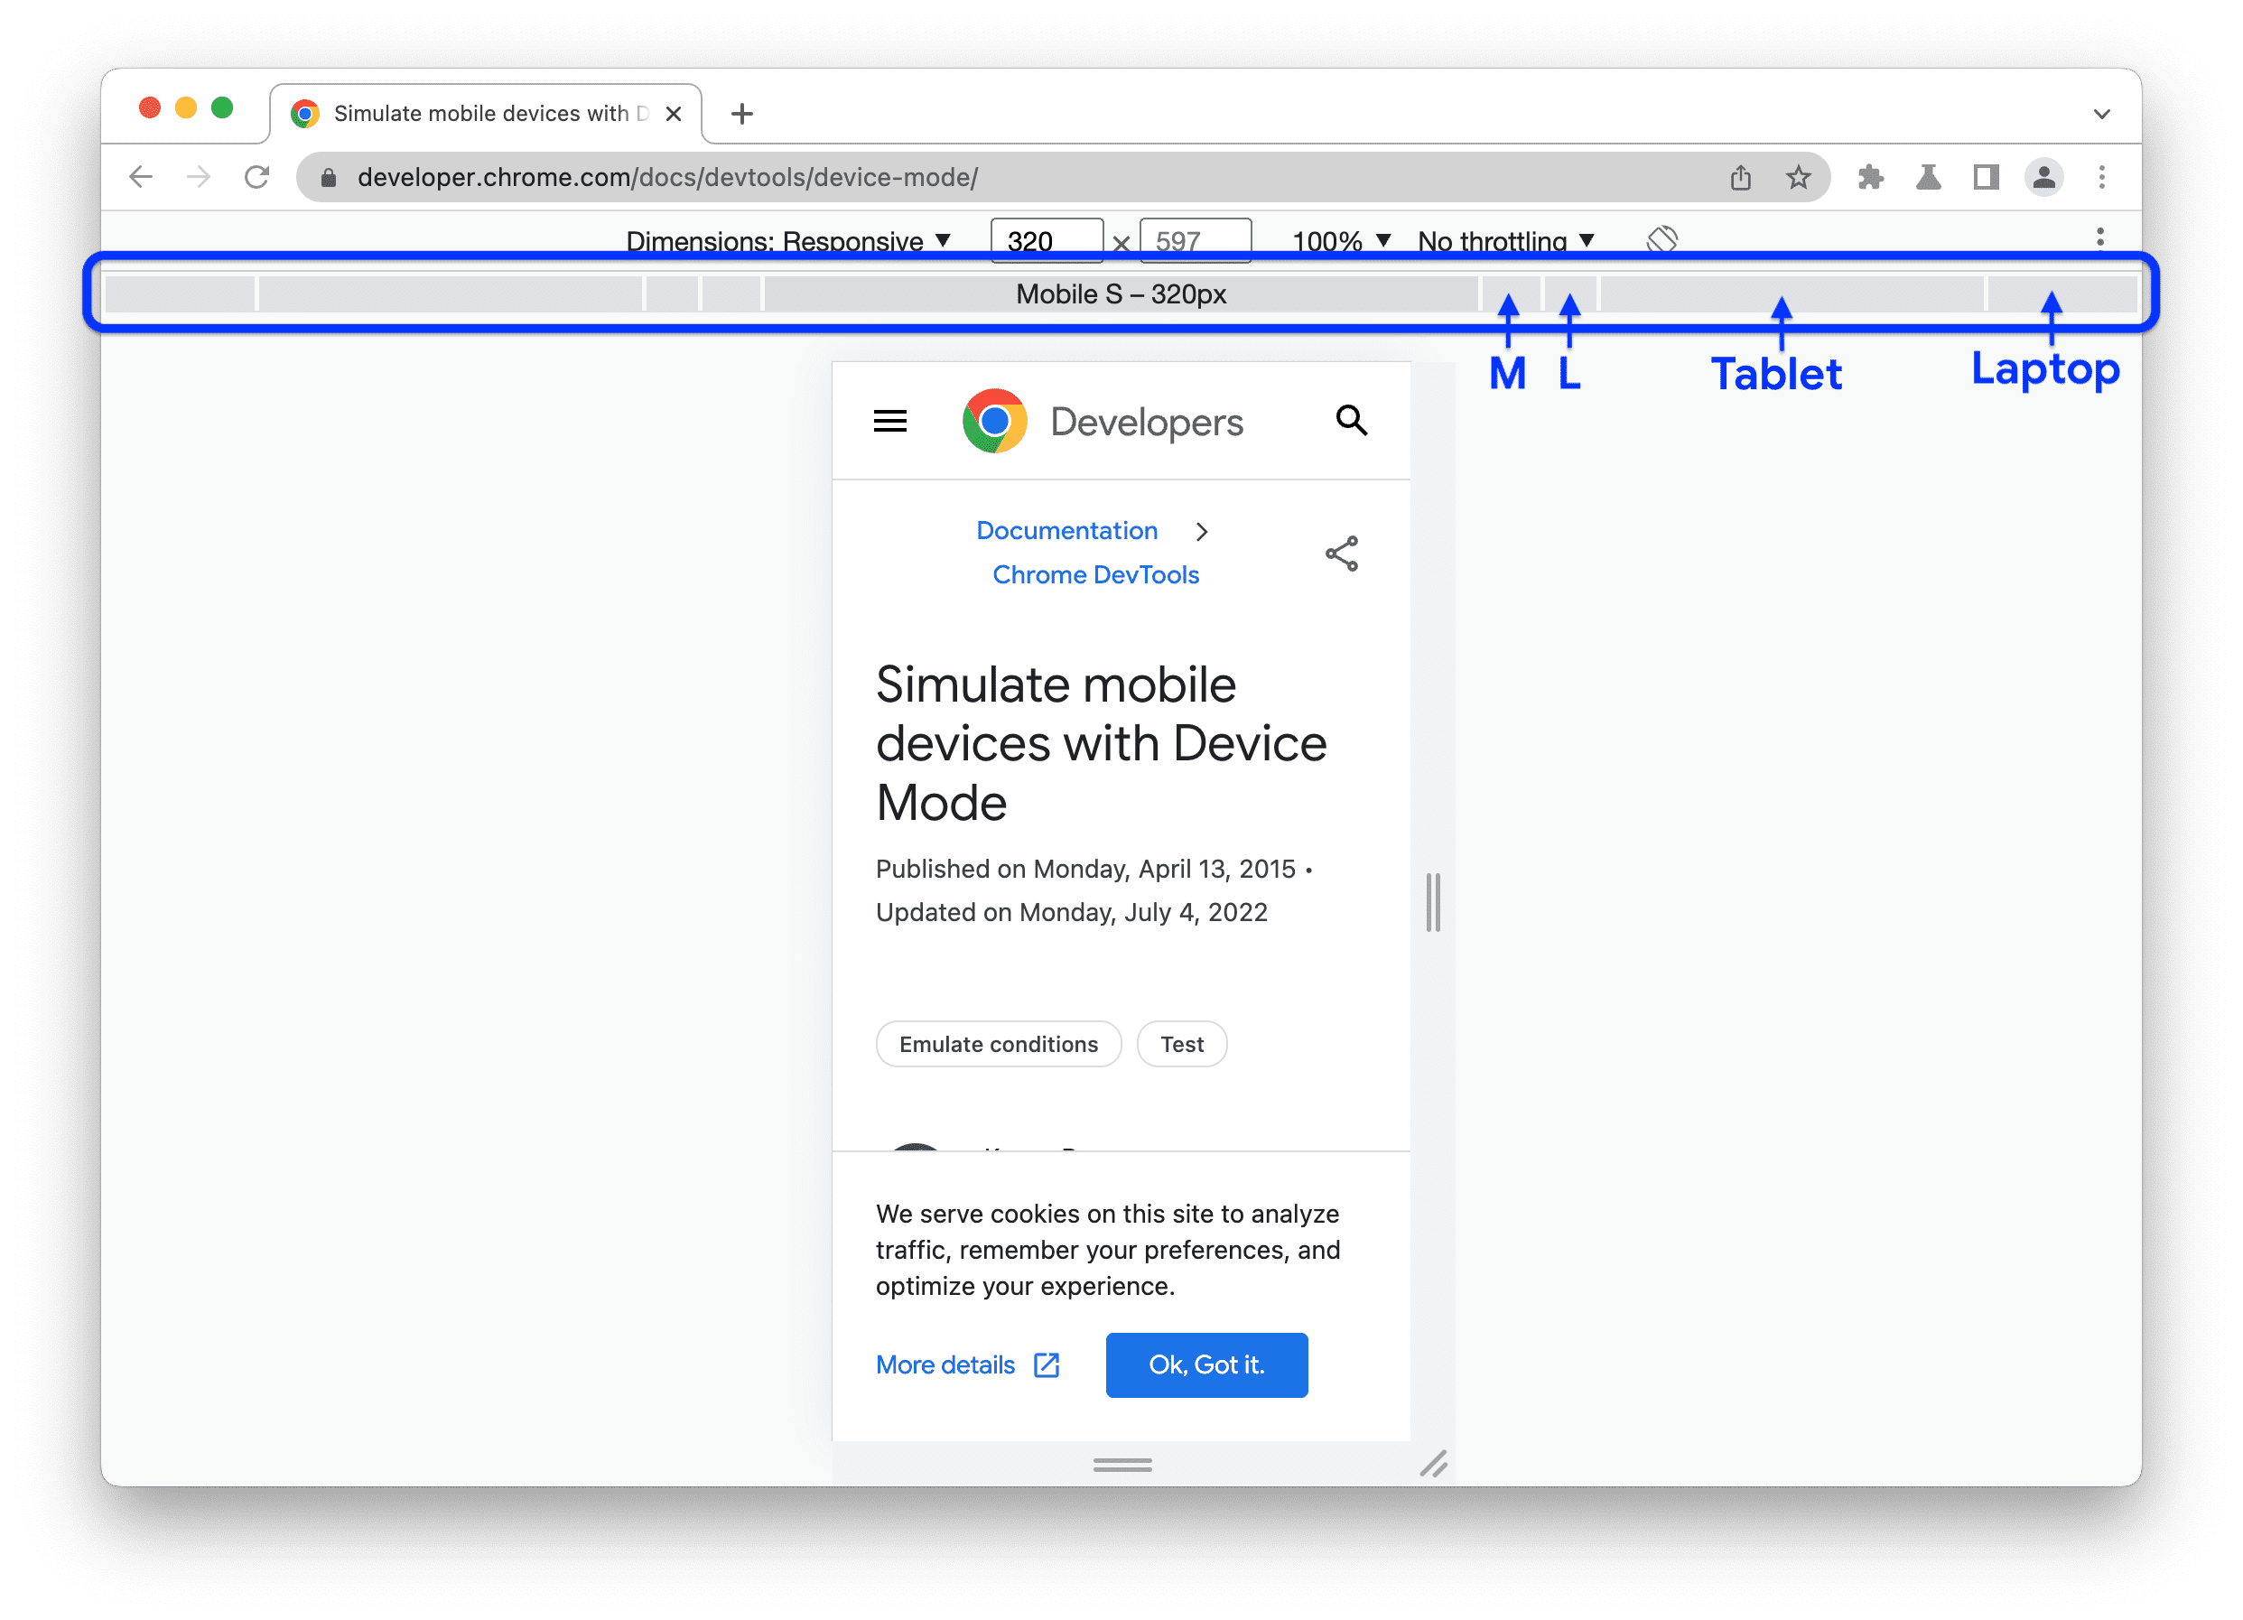
Developer Tools

Slide 27
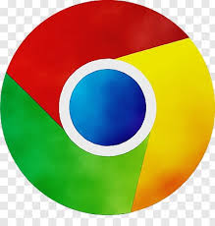


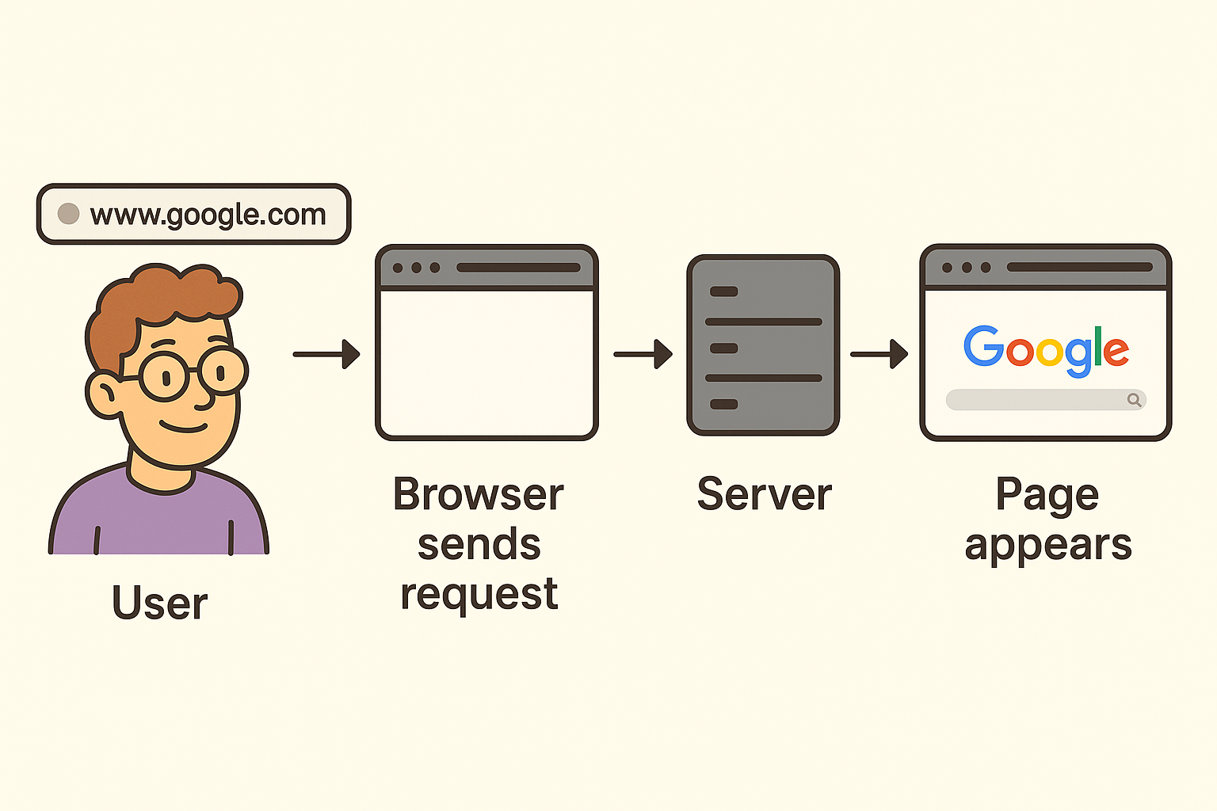
How the Web Works
Browser -
A browser is the tool you use to visit websites. When you type www.google.com in the address bar, the browser sends a request.
Server
The server is a powerful computer that stores websites. When your browser asks for a page, the server sends back the HTML, CSS, and JavaScript files

Slide 28
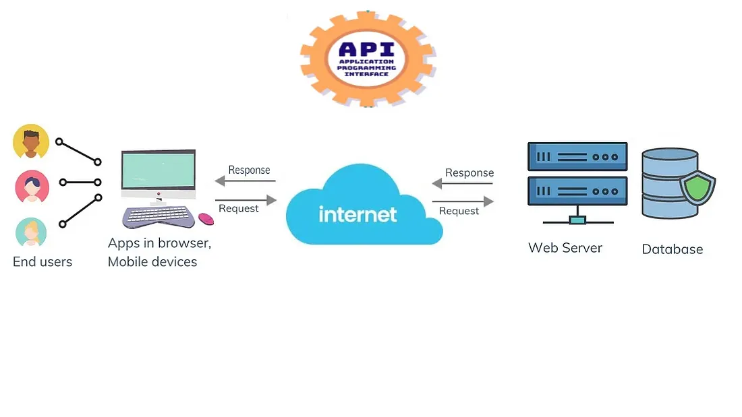
How the Web Works
APIs (Application Programming Interfaces)
APIs are like messengers that allow different apps or services to talk to each other.
Example: When a website shows Google Maps, it uses the Google Maps API to fetch data.

Slide 29
Using VS Code
Visual Studio Code (VS Code) = a free code editor for writing programs.
Supports HTML, CSS, JavaScript, and many more languages.
Features:
- Extensions (to make coding easier).
- Themes (customize look).
- Built-in terminal (run commands).

Slide 30
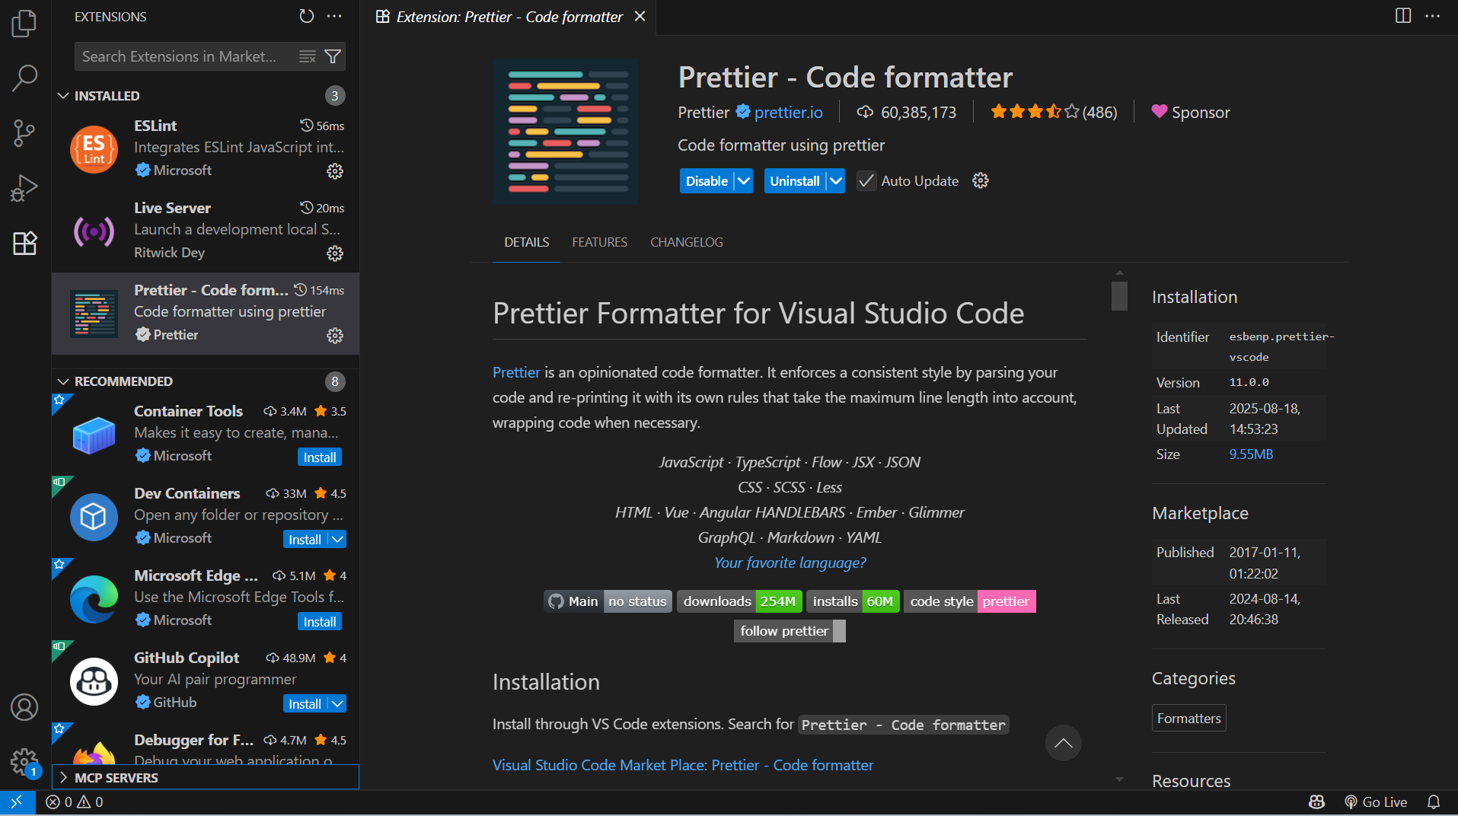
Using VS Code

Slide 31
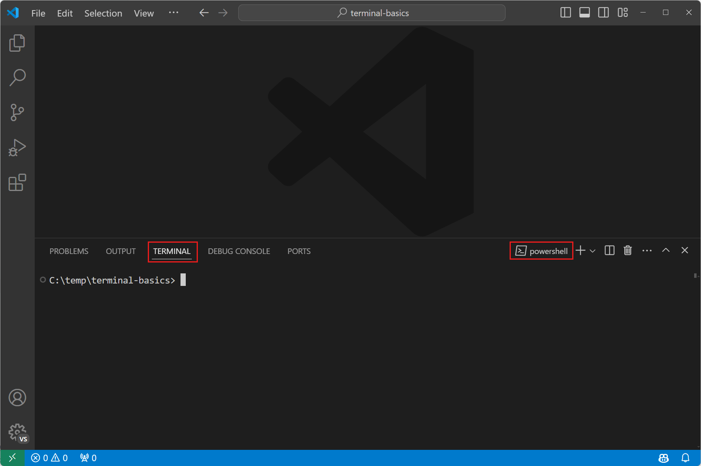
Using VS Code

Slide 32
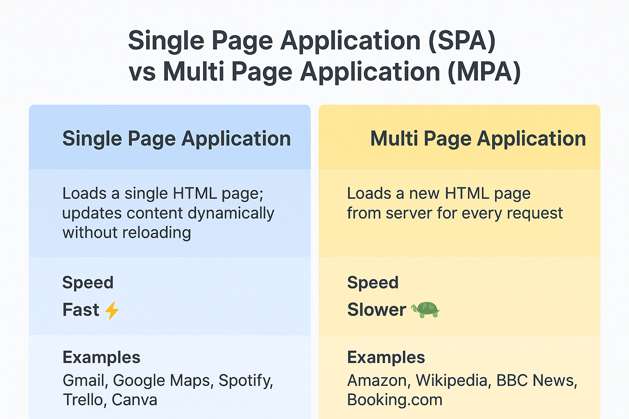
Slide Title, Segoe UI, 24pt, Max. 2 Lines

Slide 33
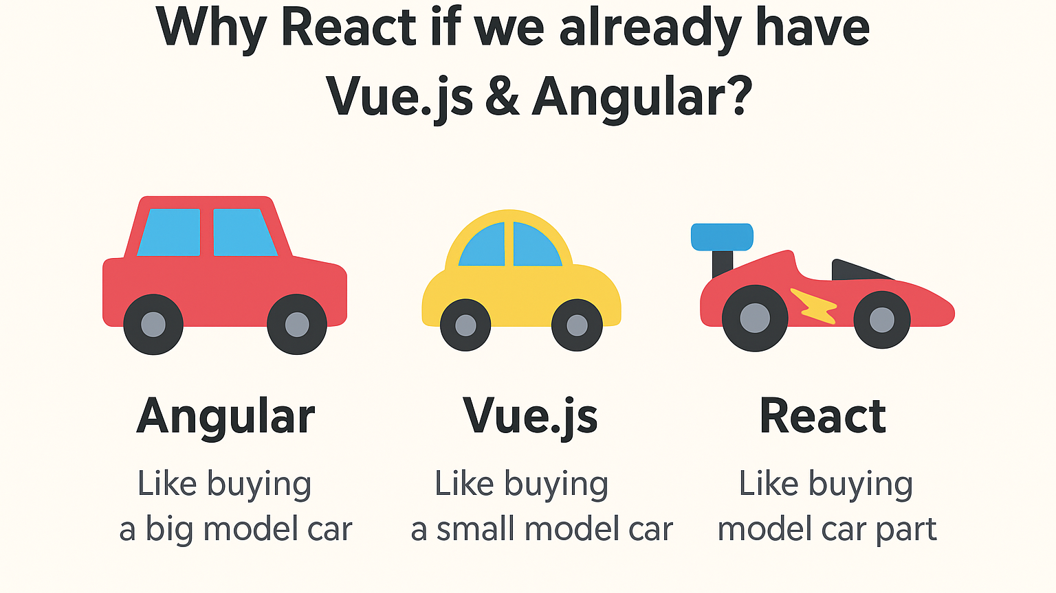
Slide Title, Segoe UI, 24pt, Max. 2 Lines

Slide 34
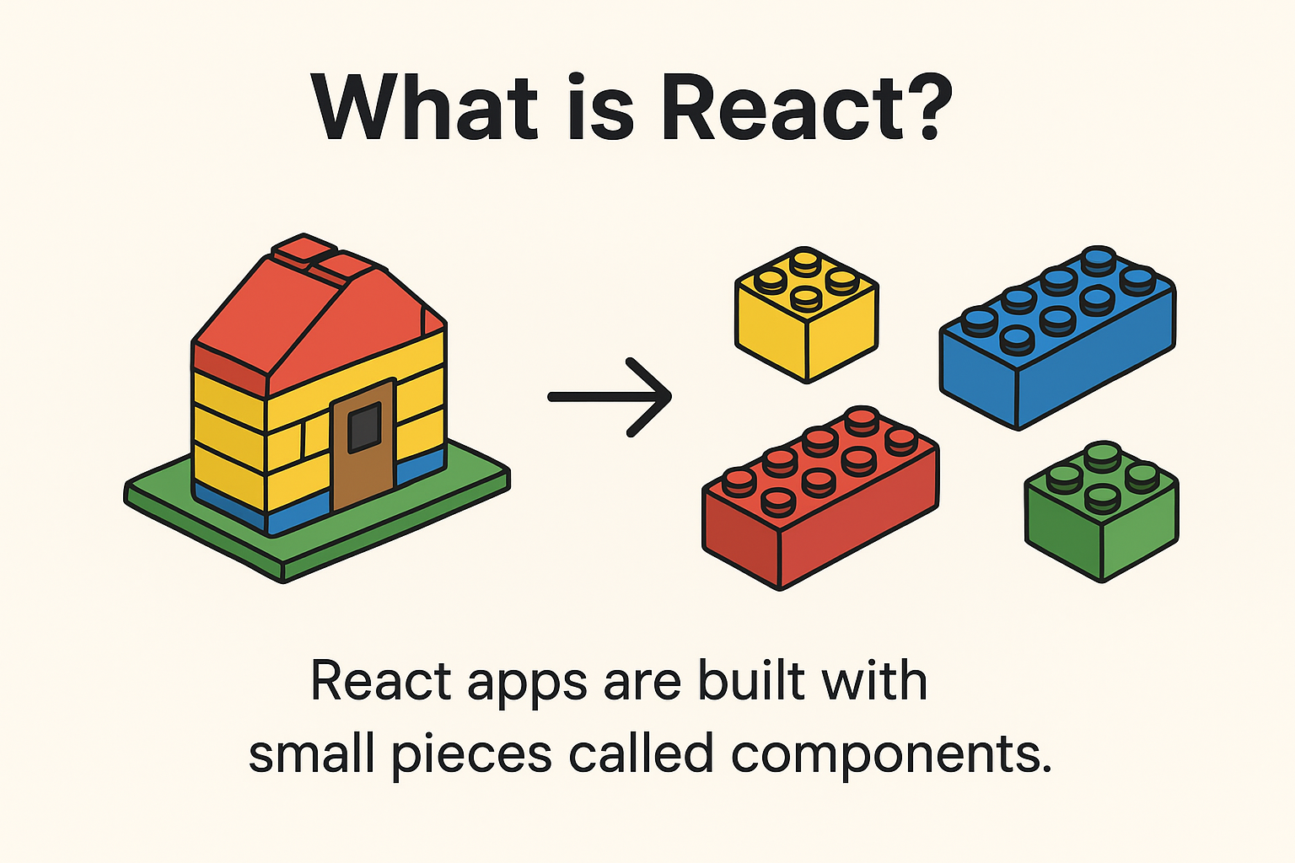
Introduction to react

Slide 35
Key features
📦 Component-based → Breaks big app into small pieces.
⚡ Fast → React updates only the part of the screen that changes.
🔄 Reusable → Build once, use many times.
🌍 Popular → Used by companies like Instagram, Netflix, Flipkart, etc.
How React works
Break UI into Components → (e.g., Button, Header, Footer).
Write JSX → Code looks like HTML inside JavaScript.
Virtual DOM → React tracks changes and updates only what’s needed.
Render UI → Browser shows updated content instantly.

Slide 36
Setting up a React Project with Vite
Prerequisites:
✅ Install Node.js (latest LTS version) → https://nodejs.org ✅ Install a code editor (VS Code).
Create a React Project with Vite
Open VS Code → Command prompt

Slide 37
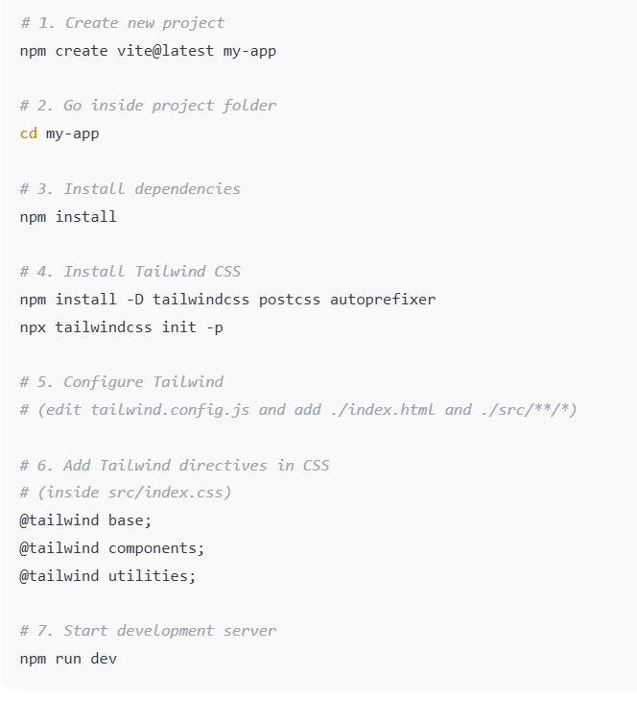
Create a react project
Open the link (e.g., http://localhost:5173/) in the browser → Your React app is running 🎉

Slide 38
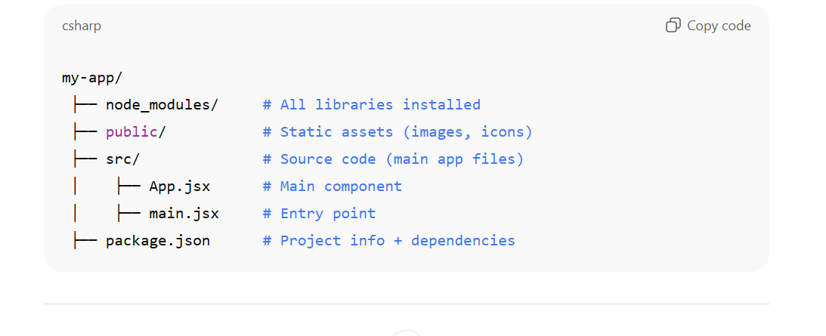
Project structure

Slide 39
JSX – Writing HTML inside JavaScript
HTML
<!DOCTYPE html>
<html>
<head>
<title>HTML Example</title>
</head>
<body>
<h1>Hello World</h1>
</body>
</html>
JAVACRIPT
<script>
const name = "World";
const root = document.getElementById("root");
const heading = document.createElement("h1");
heading.textContent = "Hello " + name;
root.appendChild(heading);
</script>
JSX
const name = "World";
function App() {
return <h1>Hello {name}</h1>;
}
export default App;

Slide 40
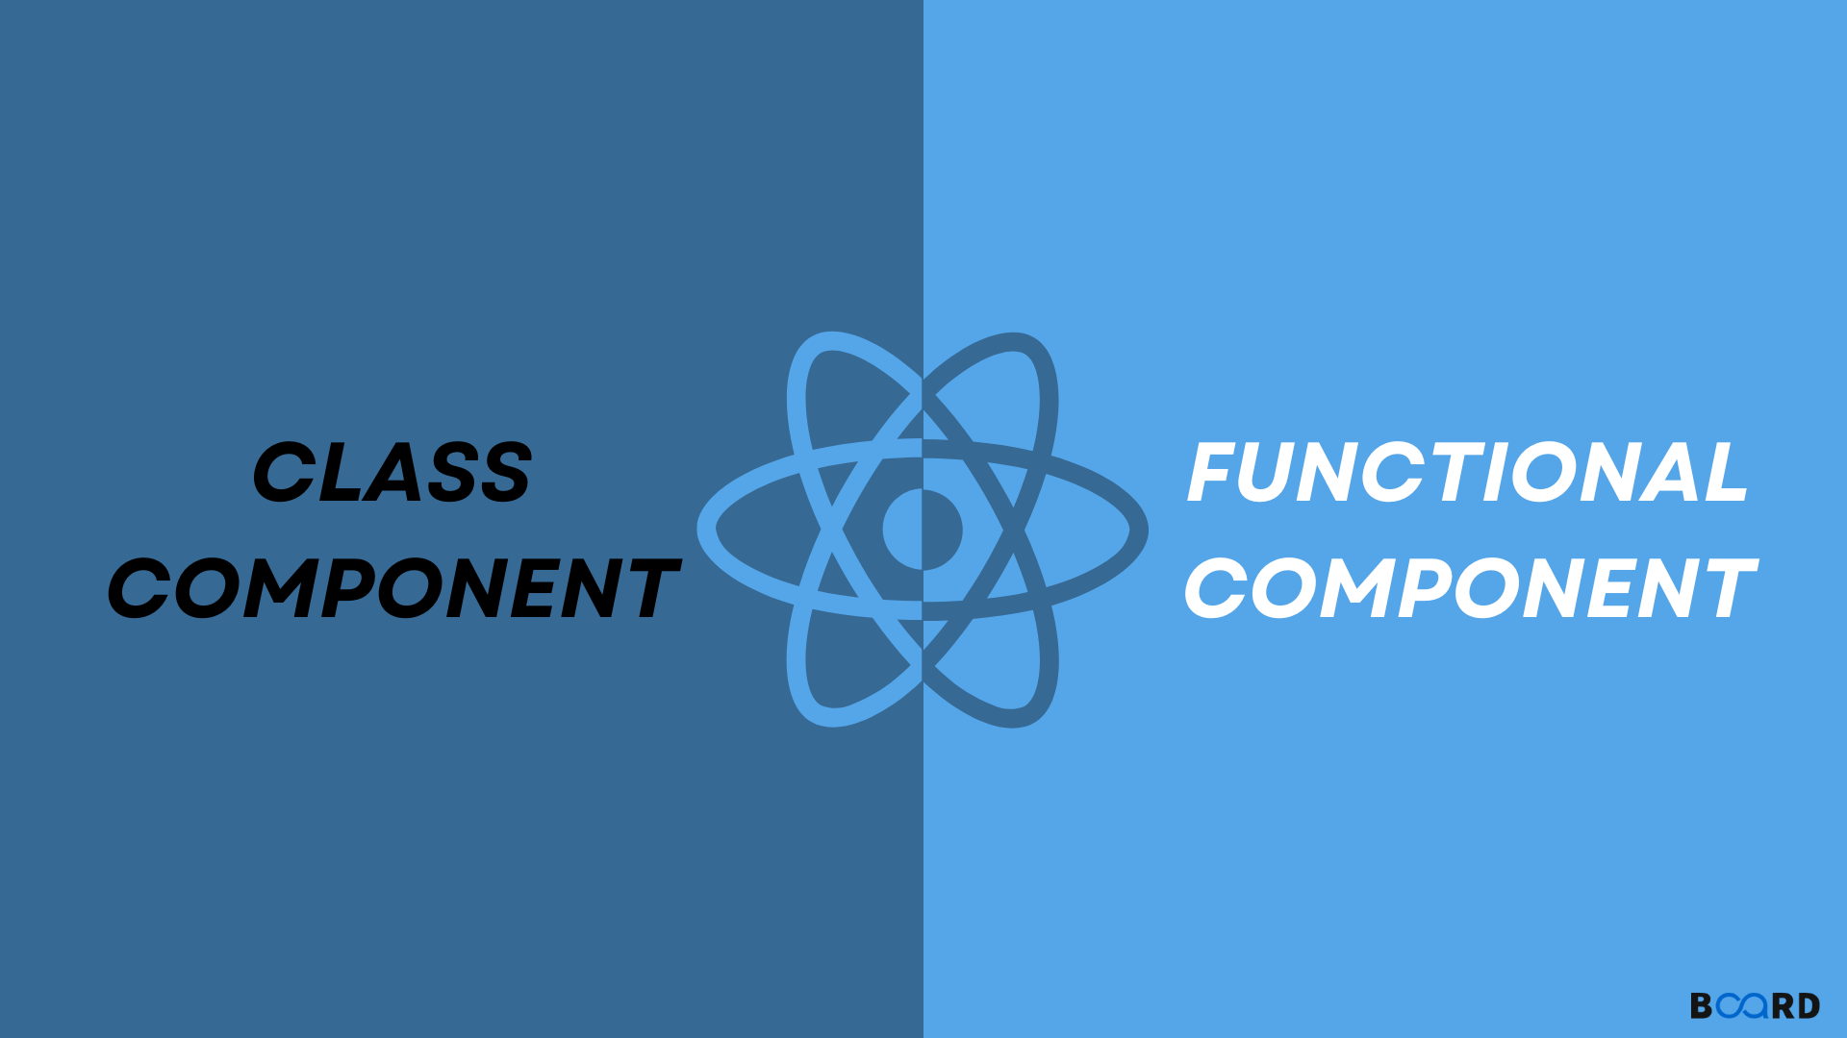
Slide Title, Segoe UI, 24pt, Max. 2 Lines

Slide 41
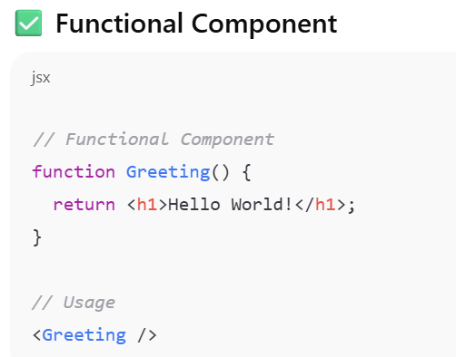
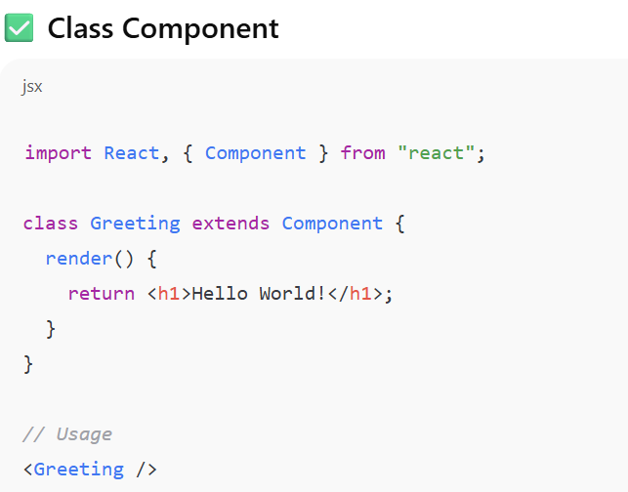
What is the difference?
Feature | Functional Component | Class Component
Syntax | Function / Arrow function | ES6 Class
State | useState Hook | this.state
Lifecycle | useEffect Hook | Lifecycle methods
Code length | Short & clean ✅ | Longer
Modern React | ✔️ Recommended | ❌ Less used

Slide 42
What are Props in React?
Props = Properties
They are like arguments to a function.
Props let us pass data from one component to another. (i.e., parent to child)
Read-only → a child component can use them but cannot change them.

Slide 43
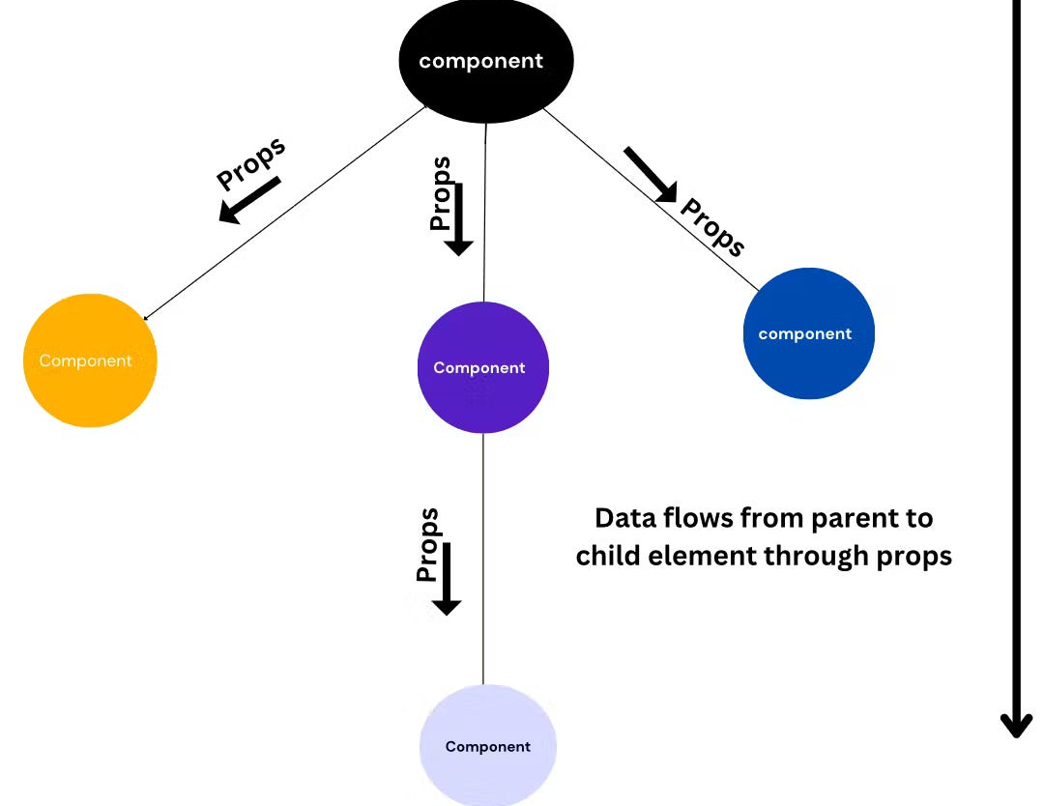
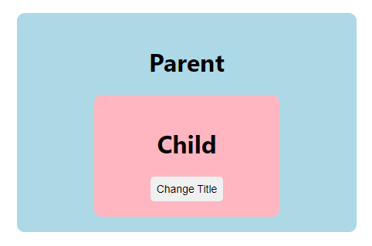
Slide Title, Segoe UI, 24pt, Max. 2 Lines

Slide 44
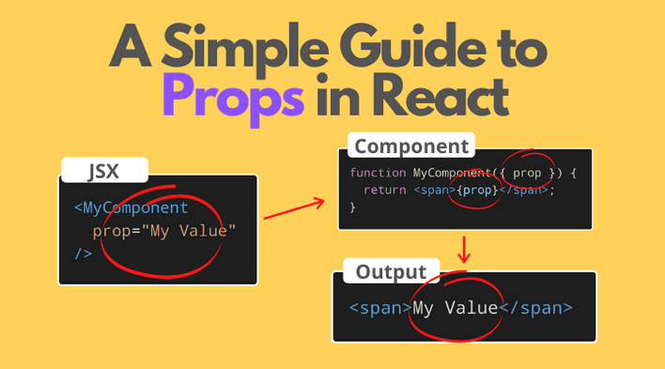
Slide Title, Segoe UI, 24pt, Max. 2 Lines

Slide 45

Passing Data from Child to Parent

Slide 46
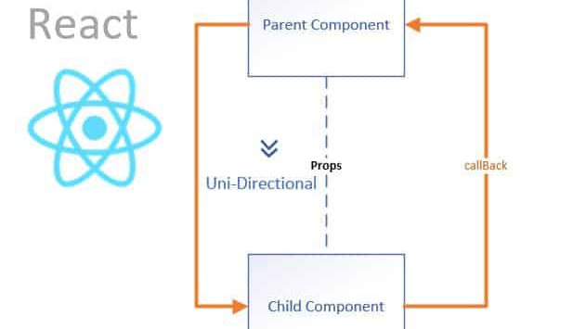
Slide Title, Segoe UI, 24pt, Max. 2 Lines

Slide 47
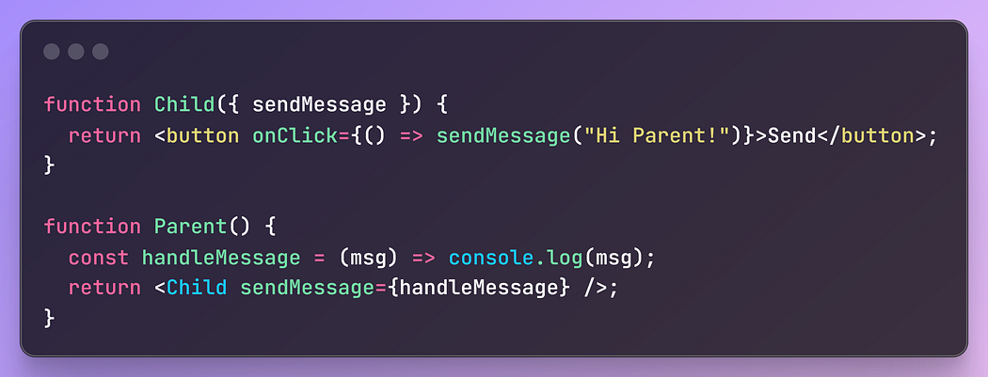
Child → Parent communication

Slide 48

State - Using useState to manage data
State = a component’s memory
state belongs to the component itself.
When state changes → React re-renders the UI automatically.

Slide 49

Slide Title, Segoe UI, 24pt, Max. 2 Lines

Slide 50
useEffect

Slide 51
What IS USEEFFECT And How to use it?
useEffect lets you run code when your component mounts, updates, or unmounts.
🟢 Mounts -> runs only once, when the component first appears on the screen.
🟡 Updates -> When you pass a state (or prop) inside the dependency array [ ], the code inside useEffect runs only when that value changes
🔴 Unmounts -> When a component is removed from the screen , React will run the cleanup function you return from useEffect

Slide 52

Slide Title, Segoe UI, 24pt, Max. 2 Lines

Slide 53

Slide Title, Segoe UI, 24pt, Max. 2 Lines

Slide 54

Slide Title, Segoe UI, 24pt, Max. 2 Lines

Slide 55


Conditional rendering (Hide/Show)

Slide 56


Lists and Keys

Slide 57




Forms in react

Slide 58

Event handling

Slide 59

Slide Title, Segoe UI, 24pt, Max. 2 Lines
In React, events use camelCase names like onClick, onChange, onSubmit.
You give the event a function → React will run that function when the event happens.

Slide 60
WHAT IS AN API?

Slide 61

Event handling

Slide 62

JSON
Looks like text → Easy for humans to read.
Has keys and values → like “name”: “Rahul”.
Language-independent → not just for JavaScript; almost every programming language can use JSON.
Mostly used in APIs → Apps send and receive data in JSON.

Slide 63

Json example

Slide 64

Using fetch with async/await
fetch() is a built-in JavaScript function, so no extra library is required.
Example: fetching a list of posts from a fake API https://jsonplaceholder.typicode.com/posts

Slide 65

Using fetch with .then()

Slide 66

Handle loading & Errors
Why do we use a loader?
Imagine you order food in a restaurant 🍔.
While waiting, the waiter says: “Please wait, your food is being prepared.”
What is error handling in React?
Error handling catches mistakes, stops the app from crashing.
It tells the user what went wrong instead of leaving them confused.

Slide 67

Rendering API data in UI
Posts
Hindi
English
Math
Science
Social

Slide 68

Introduction to react Router
React Router helps us create multiple pages inside a React app without reloading the whole website.
It’s what makes Single Page Applications (SPA) feel like they have multiple pages.

Slide 69


CREATING MULTIPLE pages

Slide 70

Navigation between components
When you click Home → it loads <Home />
When you click About → it loads <About />
When you click Contact → it loads <Contact />

Slide 71
🚀 Preparing React App for Production & Deployment

Slide 72

Preparing App for Production
When development is finished, we need to optimize the React app so it loads faster.
This creates a dist (Vite) folder with optimized files ready for hosting.

Slide 73

Git & GitHub Basics
Git helps us track changes in code, and GitHub stores it online.

Slide 74

Deploy on Netlify
Go to https://netlify.com
Login (students can use GitHub account).
Click New Site → Import from GitHub.
Select your React project repo.
Netlify auto-detects React → build command:
i.e., publish directory: dist (Vite)
Click Deploy 🎉 → app is live with a free Netlify URL.

Slide 75

Thank you.

